Slide 1
Selecting efficient and reliable preservation strategies:
modeling long-term information integrity using large-scale hierarchical discrete event simulation
Prepared for
IDCC 20200
Dublin
Micah Altman
MIT Libraries
Richard Landau
Program on Information Science
< http://tiny.cc/IDCC2020Altman >
Notes:
Alex

Slide 2
Related Work
ARXIV Preprint:
[1912.07908] Selecting efficient and reliable preservation strategies: modeling long-term information integrity using large-scale hierarchical discrete event simulation
Notes:
Alex

Slide 3
Abstract
This article addresses the problem of formulating efficient and reliable operational preservation policies that ensure bit-level information integrity over long periods, and in the presence of a diverse range of real-world technical, legal, organizational, and economic threats. We develop a systematic, quantitative prediction framework that combines formal modeling, discrete-event-based simulation, hierarchical modeling, and then use empirically calibrated sensitivity analysis to identify effective strategies.
Specifically, the framework formally defines an objective function for preservation that maps a set of preservation policies and a risk profile to a set of preservation costs, and an expected collection loss distribution. In this framework, a curator’s objective is to select optimal policies that minimize expected loss subject to budget constraints. To estimate preservation loss under different policy conditions optimal policies, we develop a statistical hierarchical risk model that includes four sources of risk: the storage hardware; the physical environment; the curating institution; and the global environment. We then employ a general discrete event-based simulation framework to evaluate the expected loss and the cost of employing varying preservation strategies under specific parameterization of risks.
The framework offers flexibility for the modeling of a wide range of preservation policies and threats. Since this framework is open source and easily deployed in a cloud computing environment, it can be used to produce analysis based on independent estimates of scenario-specific costs, reliability, and risks.
We present results summarizing hundreds of thousands of simulations using this framework. This analysis points to a number of robust and broadly applicable preservation strategies, provides novel insights into specific preservation tactics, and provides evidence that challenges received wisdom.

Slide 4
Shifting Economics of Digital Information
Going digital changes economics of long term access
Computation is cheap
Replication is cheap
Conservation (of media, hardware) is expensive

Slide 5
Multi-Level Threat Modeling
Sector
Corrupts portion of document
Detected only on file audit (silent)
Related to storage quality
HARDWARE
Glitches
Environmental Conditions
Latent (Invisible)
Periodic changes
Increases sector error rate
Server
Replica failure
INSTITUTION
Deletected on server or file audit
Entire replica of collection is lost
Shock
^{Major correlated failure}
Latent
Induces immediate server failure
May raise rate of server failure

Slide 6
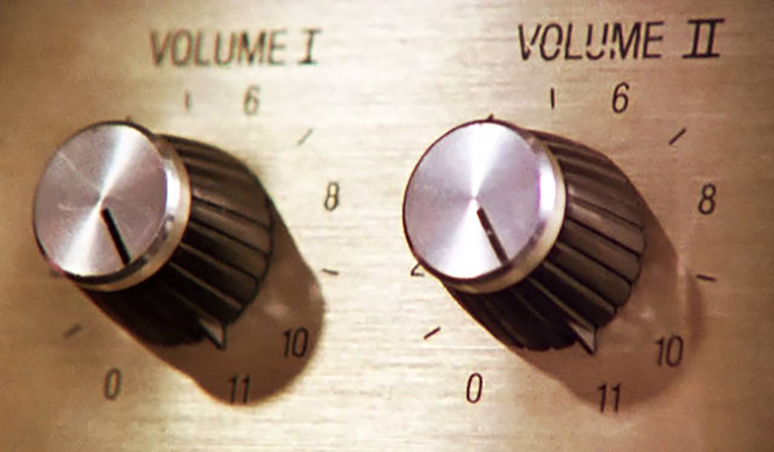
Core Preservation Actions
Replication
Auditing
Repair
Transformations
Compression
Encryption
Reformatting

Slide 7
Cost Modeling
Cost(C,S)= f(storage(C,S), communications(C,S), Replicas(S))
Simplifications:
Each separate replication imposes a fixed cost
Storage cost is linear in (compressed) collection size
Communication is linear in collection size; audit frequency
Other computation costs are negligible

Slide 8
Characterizing Preservation as Optimization
Given
A collection (C), of documents ={D1..DN};
A budget (B)
Distribution of threats P()
Choose
A preservation strategy (S) = {Copies, AuditMethod, RepairFrequency, FileTransformation}
Optimize
Choose the optimal strategy, S*, to minimize collection loss, within the budget
min_{S∗ ∋ S} E(Loss(C,S*)) | Cost(C,S*)≤ B

Slide 9
Protecting Against Hardware Errors

Slide 10
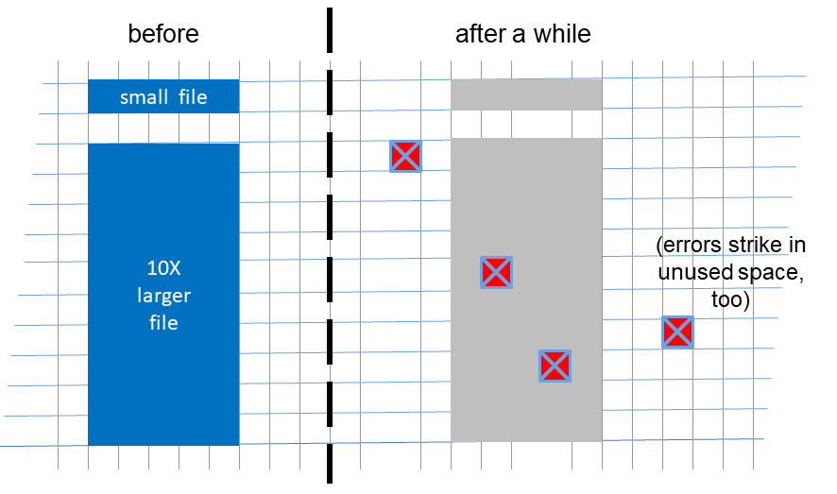
Modeling Damage to Files
Layer | Role | Visibility | Distribution | Lower Frequency | Higher Frequency (lower severity)
Storage Hardware (Sector) | Causes sector error / single document loss | Silent. | Poisson event | Controller failure | Media corruption.
Local environment (Glitch) | Increases rate of storage error | Invisible. | Poisson event of some duration | HVAC failure | Power spikes
Notes:
Note:
Sector error refers to logical sector error. RAID etc is abstracted into sector error.
Assume that hardware is maintained and after service life -- hardware left-in-place will be subject to bathtub curve failures.
Document size is important, but effects on risk are absolutely proportional. Baseline model assumes 50M document.
Failure in larger documents can be readily estimated by proportionally increasing predicted failure rate.

Slide 11
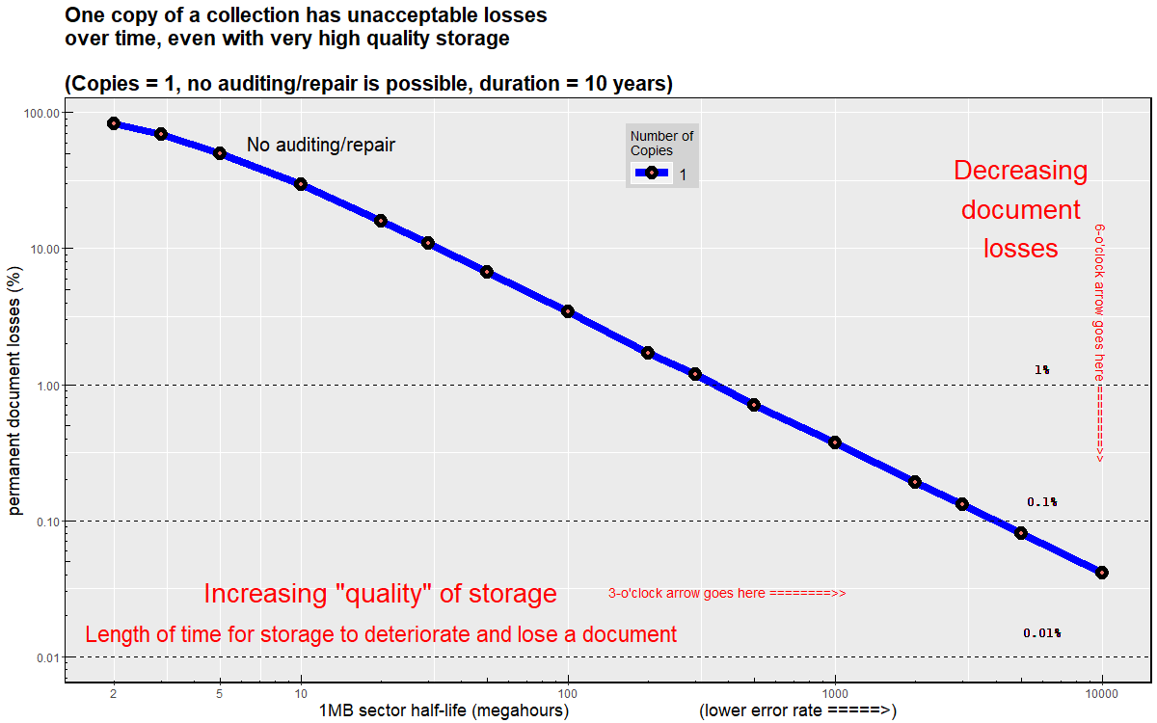
The Best Disk Hardware is Not Enough -- Make Copies
Notes:
A single

Slide 12
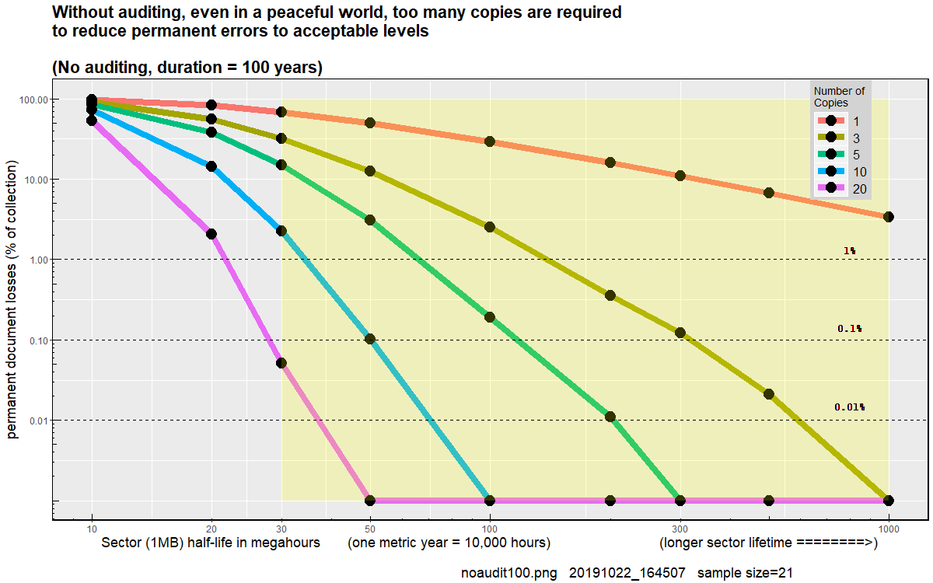
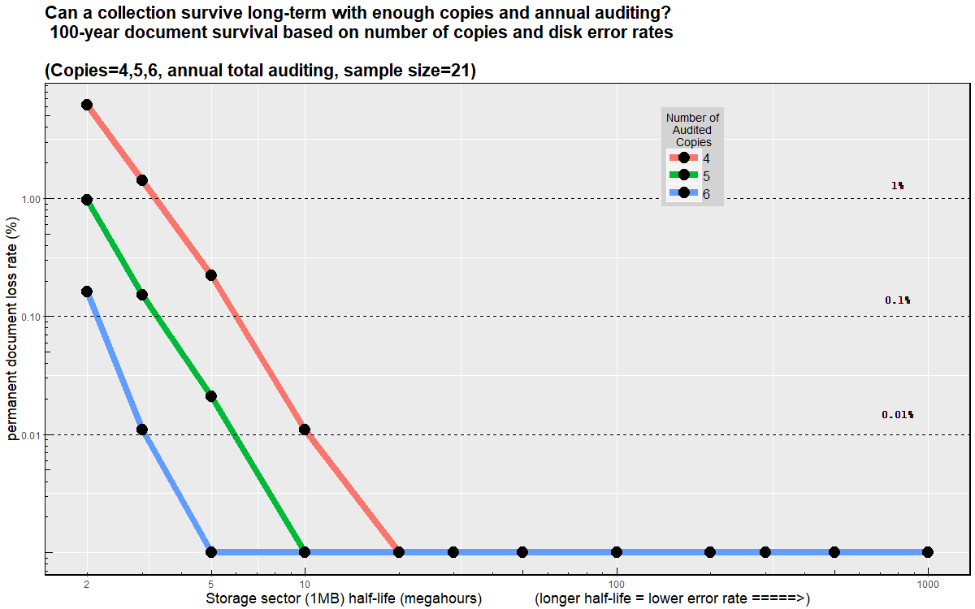
5 Copies + Systematic Annual Auditing is Sufficient Protection from Hardware Errors
Without auditing 20 copies are necessary to prevent loss over a century
With simple annual auditing 5 Copies are Sufficient
Notes:
Notes:
Sampling only a percentage, or sampling with replacement is not a good strategy
Auditing based on use is even worse strategy
Can randomize order of auditing -- but must be systematic coverage of collection during interval

Slide 13
Institutional Level Threats

Slide 14
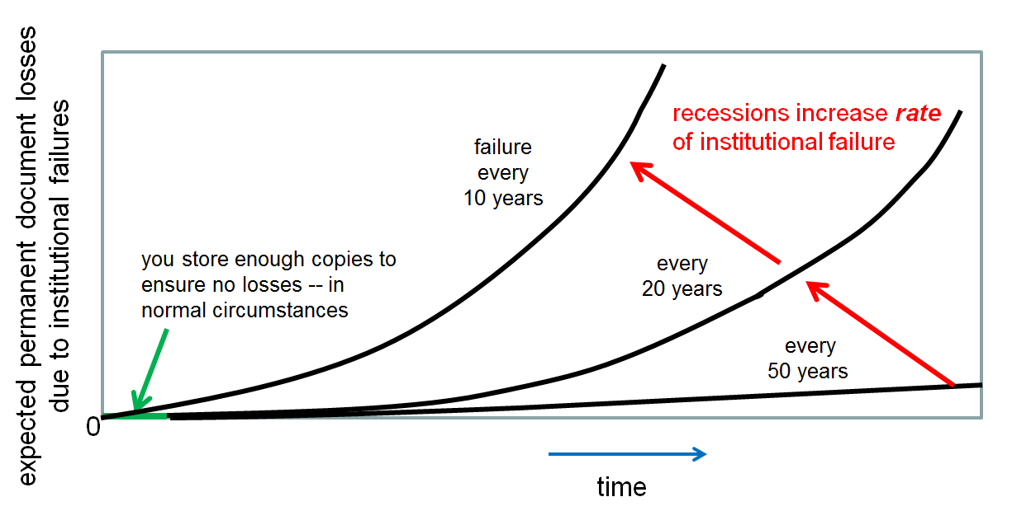
Modeling Institution-Level Failures
Layer | Role | Visibility | Distribution | Lower Frequency | Higher Frequency (lower severity)
Institution (Server Failure) | Causes loss of a single copy of a collection | Silent. | Exponential Lifetime | Ransomware Business failure | Curator error. Billing error
Macro Environment (Major Shock) | Increases rate of server failure | Invisible. | Poisson duration | Corporate Mergers | Recession
 | Immediate loss of multiple servers | Silent or visible | Poisson event | Government Suppression | Regional war
Notes:
Note:
Sector error refers to logical sector error. RAID etc is abstracted into sector error.
Assume that hardware is maintained and after service life -- hardware left-in-place will be subject to bathtub curve failures.
Document size is important, but effects on risk are absolutely proportional. Baseline model assumes 50M document.
Failure in larger documents can be readily estimated by proportionally increasing predicted failure rate.

Slide 15
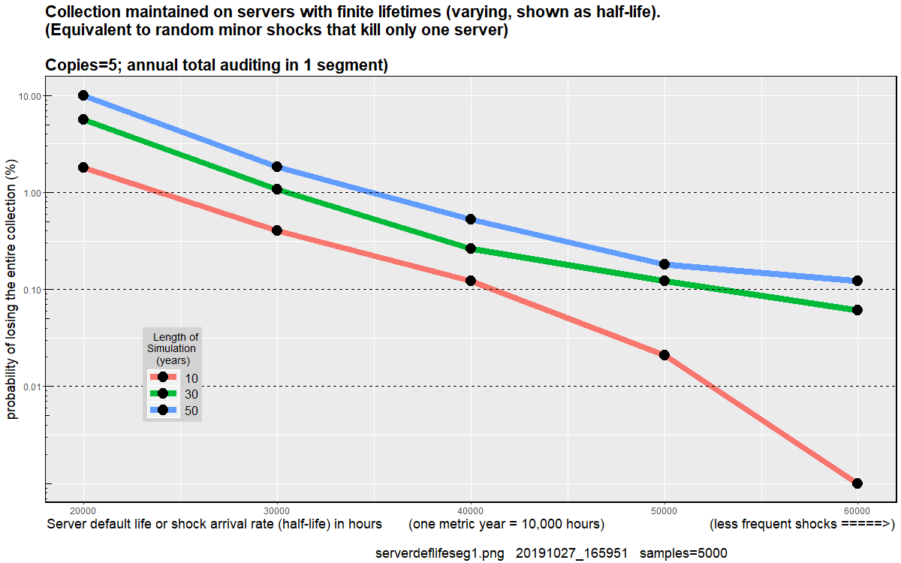
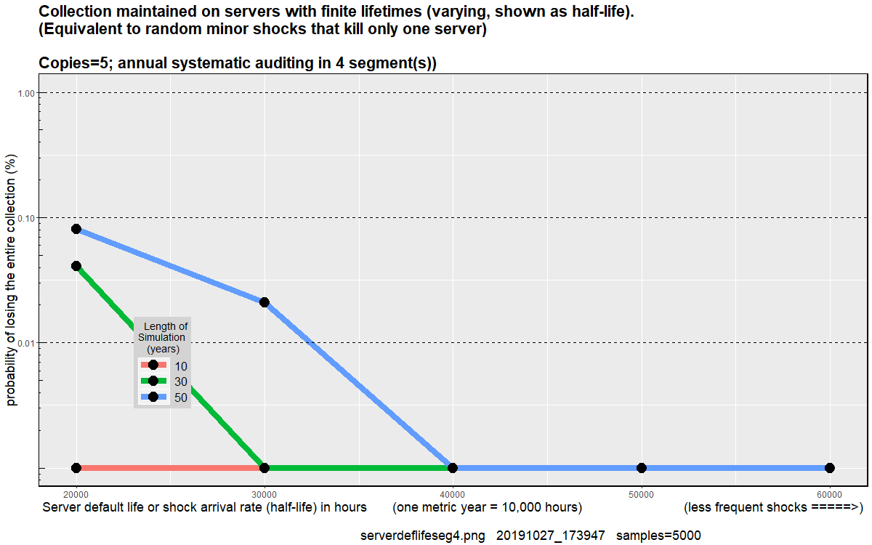
Annual Auditing Does Not Protect Against Server Failure
Annual Audits Significant collection Loss over Long Term
Dividing Audit into Quarterly Segments Controls Risk
Notes:
Note:
Assumes infinite sector life -- best case!
Half life of firms is 3-7 years n most sectors,

Slide 16
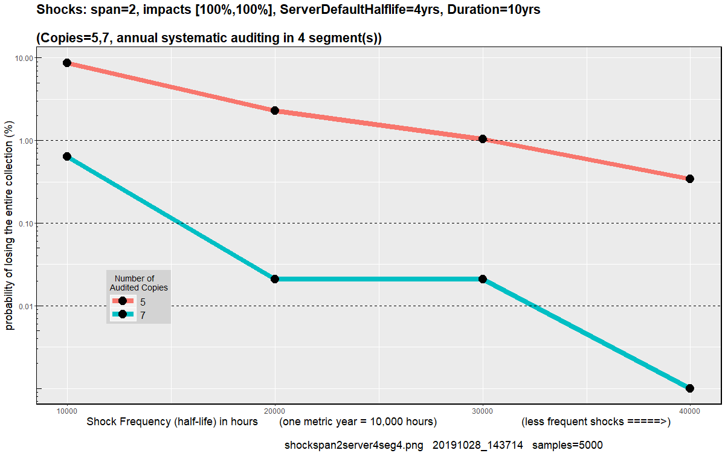
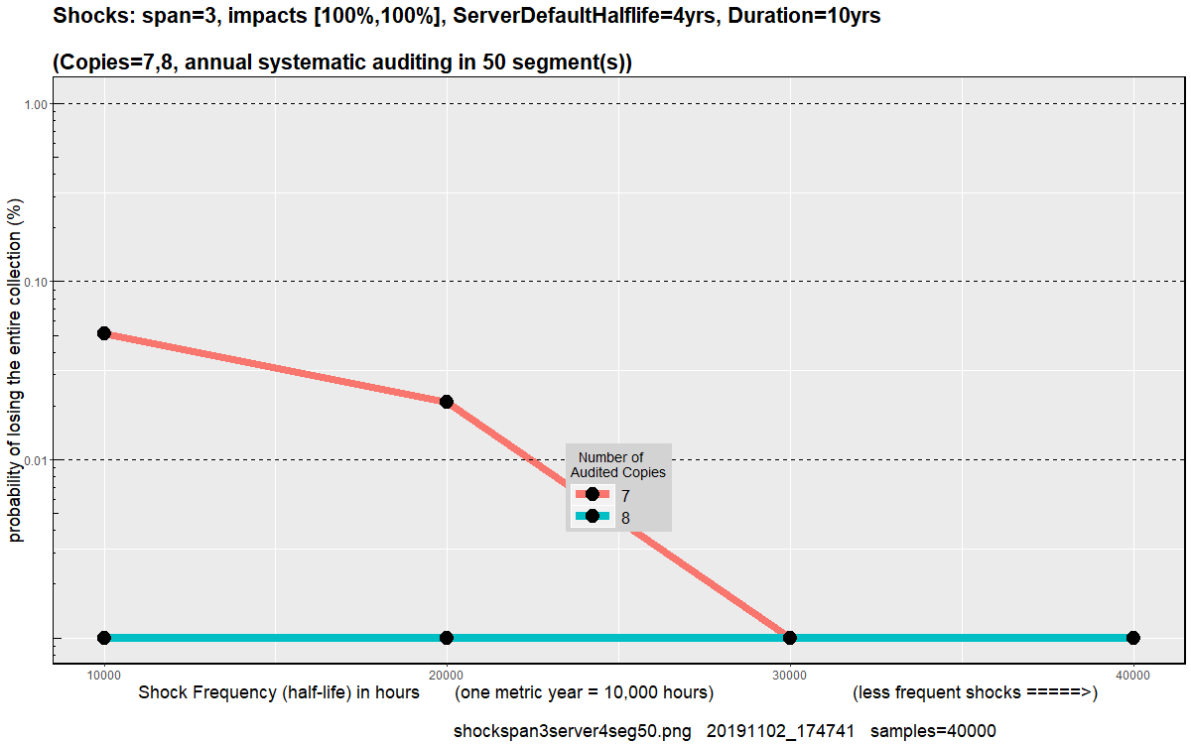
Protection for Major Recessions and Minor Wars
Weekly Server Auditing Protects Against Triple Simultaneous Server Failures
Notes:
Notes:
Include threats from targeted attacks from resourced adversary
Caveat -- replication alonge cannot prevent attack on integrity of the auditing system -- need a cryptographic protocol
Byzantine failues -- a system needs 3N*1 nodes to be safe against subverted N subverted verifiers
System of 7 replicas is safe against shock = 3 even with 1 extra node subverted

Slide 17
Managing Format Transformations

Slide 18
Managing File Encryption with Key Replication
Challenge
Entire collection is encrypted, using a set of E encryption keys
If all keys are destroyed, collection is lost
Modeling Risk
Given key size, risk of loss (not corruption) dominates
Model key failure as ‘server’ failure
Audit action:
Challenge key-holder to prove it can decrypt
Results
Replicate encryption keys (or partial shared secrets) across independent holders
Shock size and frequency are driving factors
Shock-resistant auditing strategy is sufficient

Slide 19
Managing Format Failure with Reader Verification
Challenge
Documents are encoded
K formats in collection
If format cannot be interpreted
Collection is loss
Modeling Risk
Model format failure as ‘server’ failure
Each format F is maintained by S servers
Each S holds an executable reader that can read documents in that format
Audit action:
Challenge server to prove it can read file
Results
Migrate formats when number of functioning readers is below replication threshold
Shock size and frequency are driving factors
Shock-resistant auditing strategy is sufficient

Slide 20
Compress or Repair?
Modeling
Treat large repairable documents as collection of R smaller non-repairable documents
Estimate using compression ratios for most common compression formats
1 Replica
Benefits of compression
Smaller document → reduce risk from hardware errors
Smaller collection → more replicas can be purchased and audited for fixed cost
Risks of compression
Increased fragility → single error destroys document
Compression format must be managed for format obsolescence
Compressability
Repairability
Result: Compress

Slide 21
Recommendations

Slide 22
Bottom Line
for Memory Institutions
Replicate
Don’t fear the cloud
Diversify across institutions
Audit regularly and completely
Audit storage, formats, secrets
Compress
for Vendors
Forget 11 nines … reveal replication strategy
Collect and share loss rates
Support auditing primitives
Disclose institutional dependencies

Slide 23
